Slide 1

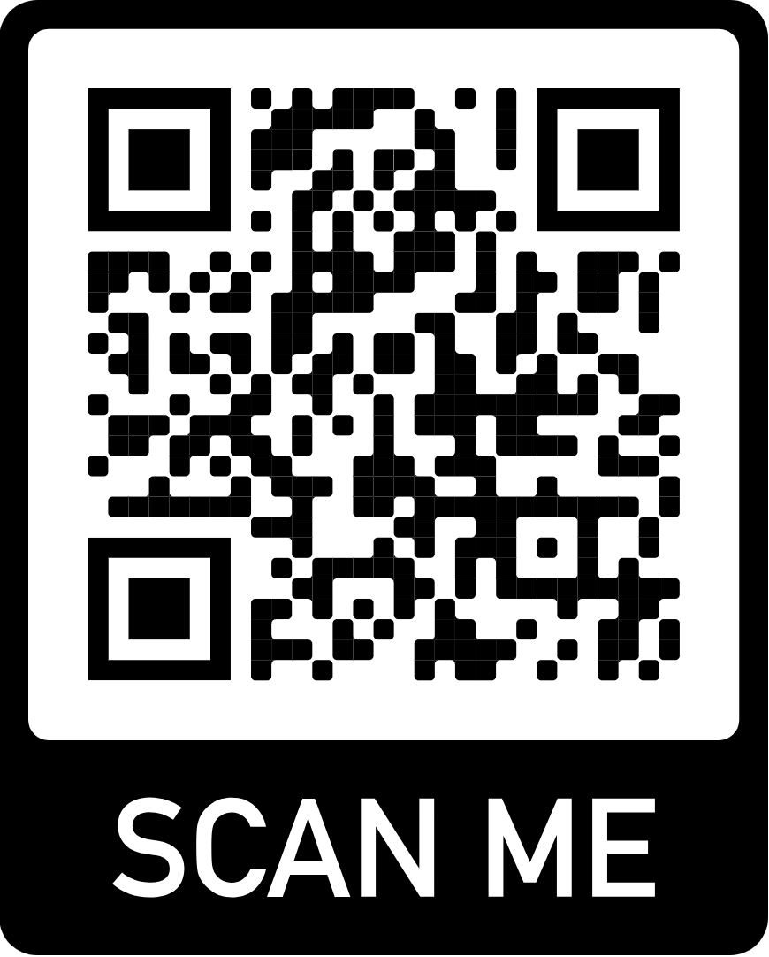

Implementing Neural Network To Make Image Recognition Better.
Arnesha Nicholas
De’andre Johnson
Oruru Ndu-Nwogu
Dr. Daniel Vrinceanu (Advisor)
Dr.Lila Ghemri (Professor)
The Problem
Steps
Conclusions
Using a Neural Network model to determine if an image is a dog or cat.
1
Prepare Workspace on Jupyter Notebook
Import dataset
Clean the data.
2
Visual layout will help you to present the research.
Only include results that support the key statement on top
White space focuses attention to the important bits.
Create data model
Train model
Split data into two:
Training Data
Prediction Data
Tools
Language Used: Python
Platform Used: Jupyter Notebook
Libraries Used: Numpy, Pandas, Matplotlib, Tensor Flow
Objective
Further info
Model should be able to predict if an
image is a
dog or a cat.
Paper Title
Co-Author No.1, University
Another author, Another university
A related paper of yours, year
Another paper, year
Your web address, QR code of the paper, and other info
Methods
4
3
Deep Neural Network using three layers: input, hidden & output layers.
Input receives the signal, the hidden layer processes it and the output layer makes a forecast about the input data.
Computer Vision: Make a prediction using a dataset without labels(prediction data)
Evaluate & Improve.
Download this template:
Or visit:
http://peerrecognized.com/poster
Divide training data into two:
Training data: 70%
Test Accuracy: 30%
Acknowledgments
Reference to the funder
Conflict of interests statement
Logos of partners
This poster was made using the “Presenter’s Poster” template from
Notes:
Download this template at http://peerrecognized.com/poster

